Slide 1
QUANTITY AND COST ESTIMATION OF RESIDENTIAL BUILDING
Submitted By
M.SURYA NARAYANA 14FF5A0105
K.NAGARAJU 14FF5A0104
N.SOMARAJU 14FF5A0106
G.SAIKUMAR 13FF1A0108
B.SANTOSH KUMAR 14FF5A0103
M.PRAKASH 13FF1A0115
A.RAMBABU 14FF5A0101

Slide 2
ABSTRACT
This document appendix of project development procedure manual (PDPM). The project development quantity and cost estimates of each items (walls, excavation, column, plastering, painting, ceiling, flooring, etc...) includes the policy and procedures required for developing project quantity and estimates. This document provides minimum guidance necessary to develop reasonably accurate cost estimates but doesn’t take place of experience and prudent engineering judgment. This guidance included discussion of many different factors that affect project cost estimates. Estimator should consider all of these factors as necessary in developing project cost estimates.

Slide 3
INTRODUCTION:
Before taking up any project for its execution the owner or builder or engineer should have thorough knowledge about the volume of work that can be completed within the limits of his funds. It becomes necessary to prepare to estimate or probable cost for the intended work from the given drawings and specifications. If the probable cost is more than the funds available, attempts are made to lesson the cost by reducing work or by changing or altering specifications or modifying certain items.
There is no hard and fast rule for finding out the dimensions from the drawing (plans, elevation, sections, etc..) but for quick work certain principles, may be followed. Beginners find it difficult to take dimension (length, breadth and height) from the plan, elevation and section, but they can easily find out the dimensions by measurements from the existing building. Foundation is more difficult for the beginners as it is not exposed and not visible. An estimator should picture the object (building, structure, etc...) in his mine from the study of drawing and specifications.

Slide 4
DETAILED ESTIMATION
Preparation of detailed estimate consists of working out the quantities of different items of work then working out the cost that is the estimate is prepared .
Details of measurements and calculation of quantities:-
The whole work is divided into different items of work as Earth work, concrete , brick work etc. and the items are classified and grouped under different sub-heads, and details of each item of work are taken out and quantities under each item are computed in prescribe form
DETAILSOF MEASUREMENT FORM:-
S.NO | DESCRIPTION OF ITEM | NOS | LENGTH | BREADTH | DEPTH | QUANTITY

Slide 5
CENTRE LINE METHOD
EARTH WORK
CONCRETE IN FOUNDATION
SOLING
DAMP PROOF COURSE
MASONRY
R.C.C
FLOORING AND ROOFING
PLASTERING AND POINTING
PILLARS
DOORS AND WINDOWS
WOOD AND IRON WORK
PAINTING

Slide 6
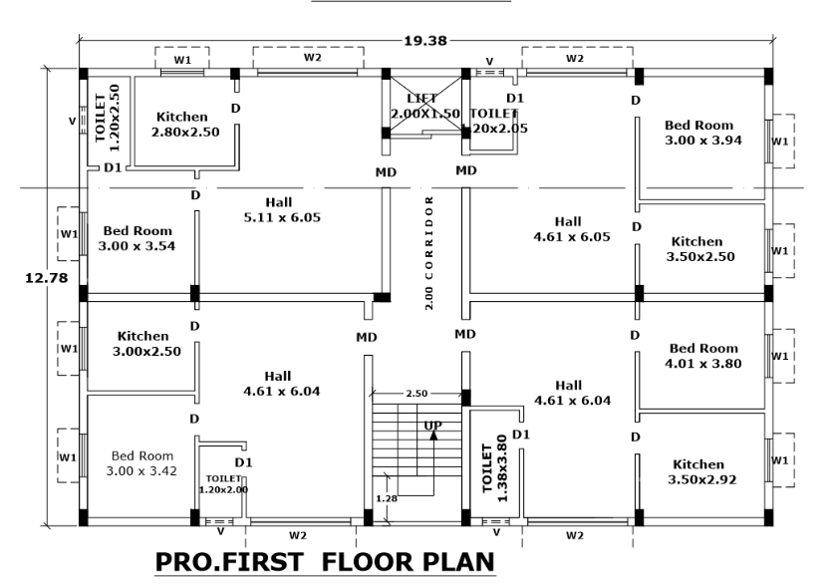

Slide 7
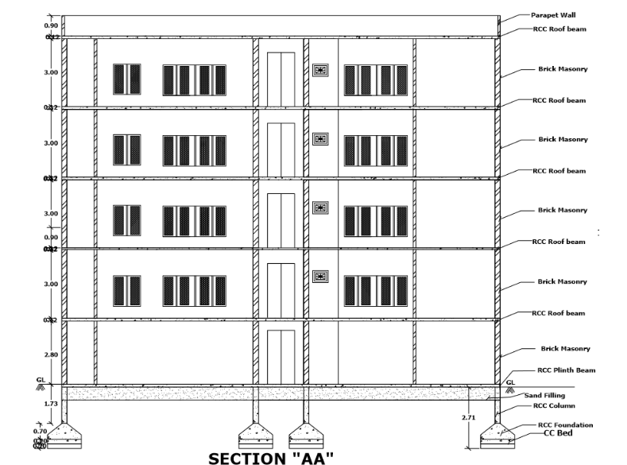

Slide 8
ESTIMATION OF QUANTITY OF STEEL OF R.C.C ELEMENTS
INTRODUCTION:
In olden day’s availability and usage of steel as reinforcement is less. After introduction of steel size of the members are reduced, self weight is reduced tremendously, strength, durability and life of the structure increased. Almost all engineering structures R.C.C is used sparingly. Estimation of steel is to be included as a separate item in abstract estimate. Bar bending schedule are very much useful in bending of bars for the required size and shape.
METHOD OF ESTIMATE OF STEEL:
Estimation of steel from the structural drawings
Estimation of steel on the percentage basis of concrete

Slide 9
ANALYSIS OF RATES AND ABSTRACT ESTIMATION
INTRODUCTION:
The determination of cost per unit of particular item of work, from the cost of material cost of labour charges, cost of machinery hire charges, VAT, Pretty super vision charges, contingencies, contractors profit etc. for its completion is known as the analysis of rates. The rates of materials and Labour charges vary from place to place.
ABSTRACT ESTIMATION:
The cost under item of work is calculated from the quantities already computed at workable rate, and total cost is worked out in a prescribed form, abstract estimation.
ITEM NO | DESCRIPTION OR PARTICULARS | QUANTITY | UNIT | RATE | AMOUNT

Slide 10
CONCLUSION:
Before taking up any project for its execution the owner or builder or engineer should have thorough knowledge about the volume of work that can be completed within the limits of his funds. It becomes necessary to prepare to estimate or probable cost for the intended work from the given drawings and specifications. If the probable cost is more than the funds available, attempts are made to lesson the cost by reducing work or by changing or altering specifications or modifying certain items.

Slide 11
Thank You

