Slide 1

DESIGN AND DEVELOPMENT OF AIR CONDITIONING SYSTEM WITH SOLAR THERMAL ENERGY
SUBMITTED BY
K. CHANDRASEKHAR
SAI BHARATH SRAVAN KUMAR
Y.MOHAN KRISHNA
S.PRASHANTH

Slide 2
ABSTRACT
This project aims that developing a hybrid solar-assisted air conditioner system.
we proposed a new solar hot water storage tank with solar vacuum tubes , the refrigerant is passed through the heated water.
Thus the novel development system is fulfilling the cooling demand. Depends upon climatic condition , 25 to 43% of monthly electricity can be saved on average.

Slide 3
INTRODUCTION OF A.C
Air conditioning may be defined as the process of achieving and maintaining a temperature below that of the surroundings,
The aim being to cool some product or space to the required temperature.

Slide 4
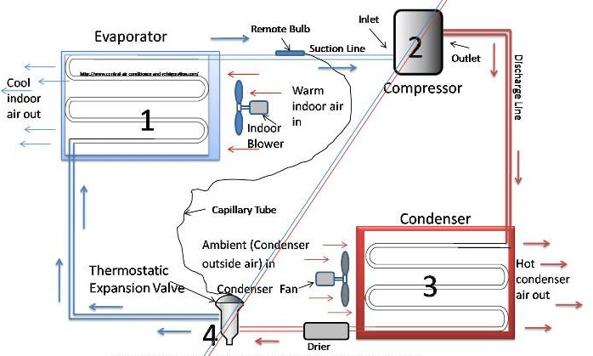
GENERAL CYCLE OF A.C SYSTEM

Slide 5
In this A.C system ,we added solar thermal energy by solar vacuum tubes between the compressor and condenser .
AIR CONDITIONING SYSTEM ADDING SOLARTHERMAL ENERGY(After compressor and before condenser) WORKING & ANALYSIS :-
Technically, solar energy is applied to
air conditioning systems either by
photovoltaic panels or heat absorption
systems.

Slide 6
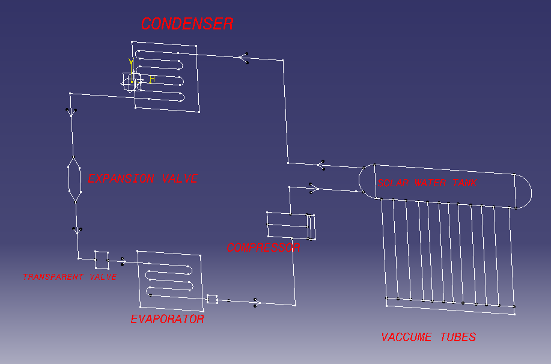
Air conditioning system adding solar thermal energy

Slide 7
SYSTEM WORKING AND DESCRIPTION
The refrigerant after evaporation in saturated
vapour condition enters in to the compressor.
At that stage refrigerant at low temperature
and low pressure .
It enters into the compressor and compressed
with high pressure, then passed through the solar
heated water tank using sun radiation.

Slide 8
> The gas leaves the solar tank with high temperature and pressure at super heated condition without any moisture content in the gas. > The condensation of gas is easy to convert into liquid, occur quicker at high temperature and pressure . > Refrigerant got more cooling after condenser and performance is increased in cycle.

Slide 9
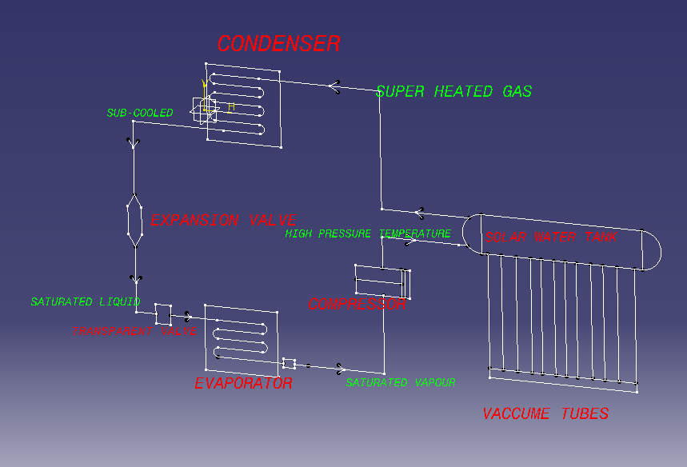
Refrigerant conditions in cycle

Slide 10
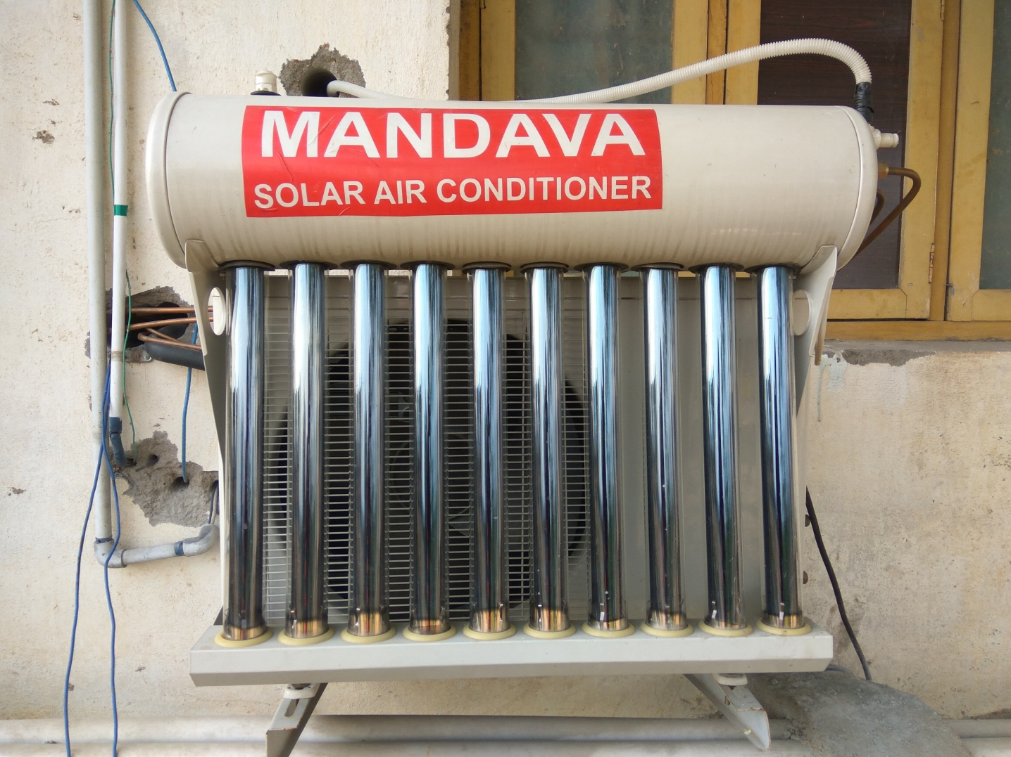
Components of solar A.C
Solar vacuum tubes with hot water storage tank

Slide 11
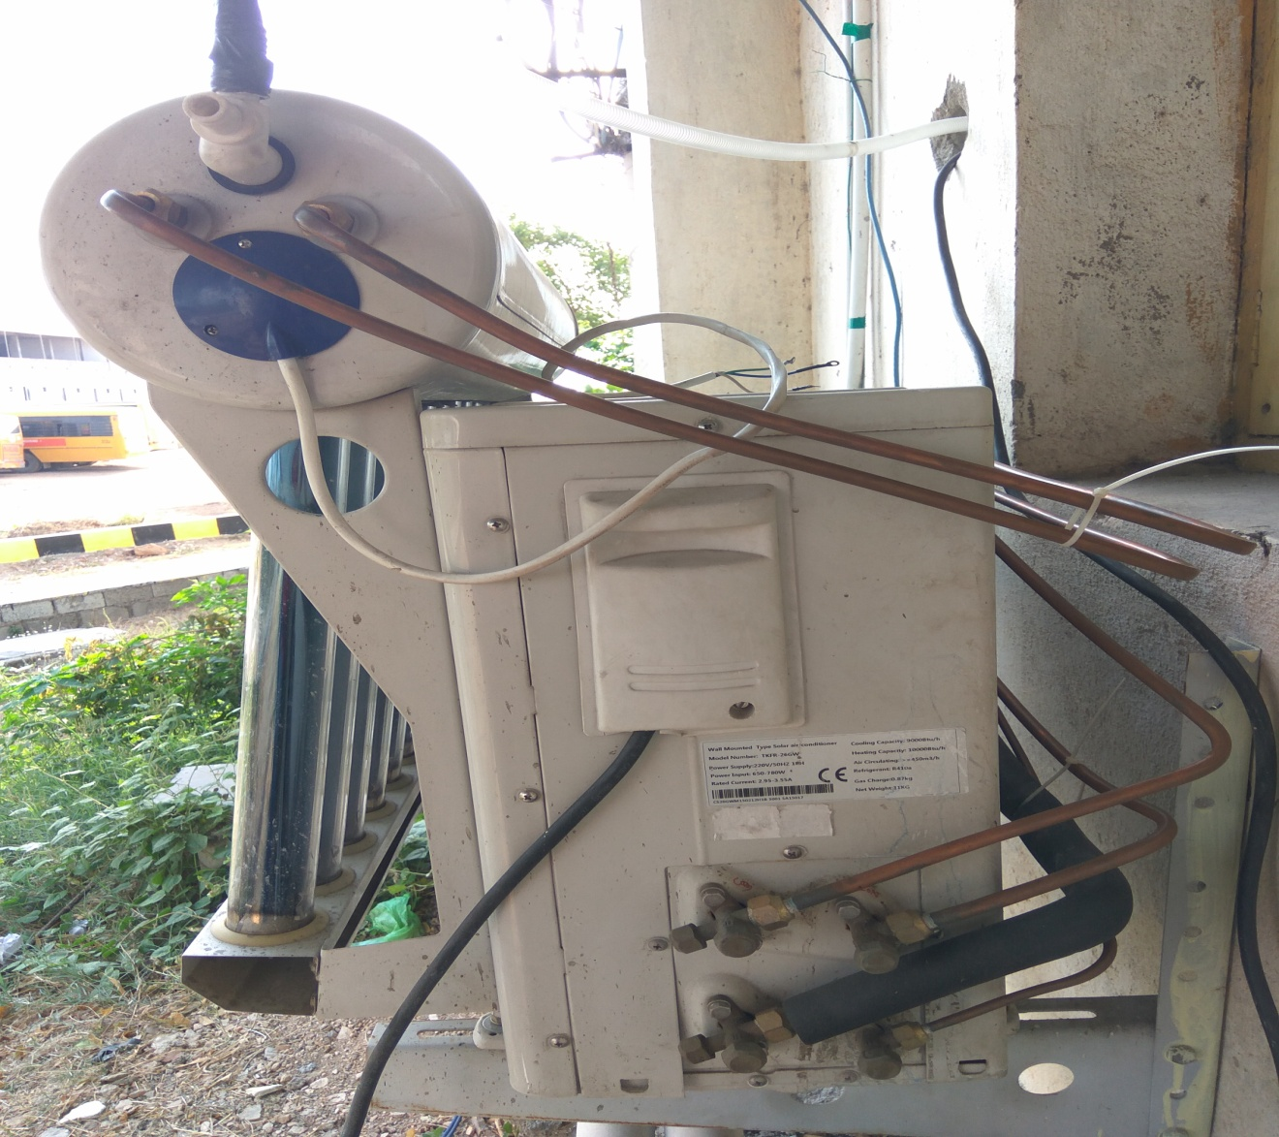
Fittings of copper tubes to the system

Slide 12
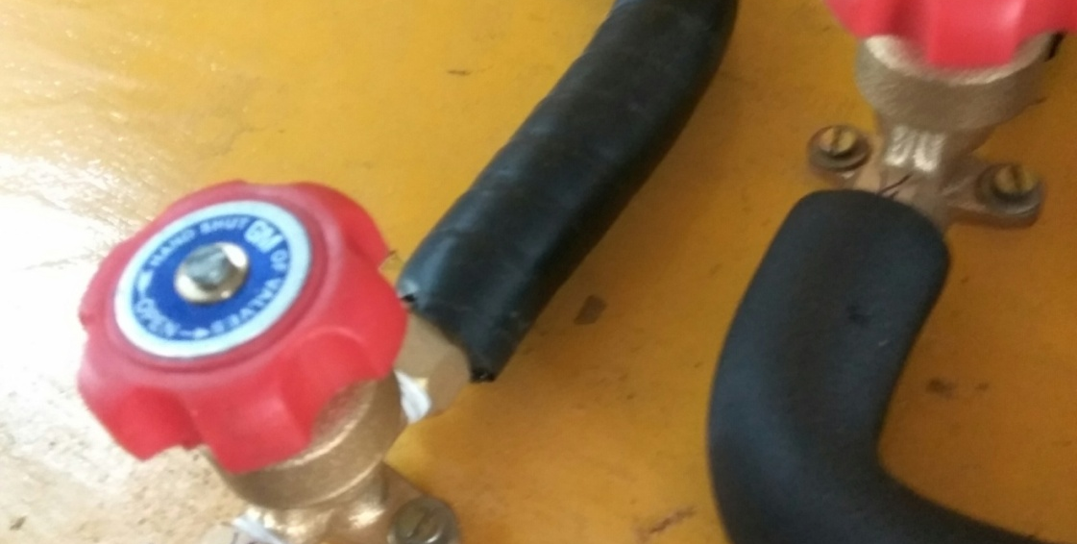
OPEN AND CLOSE VALVES

Slide 13

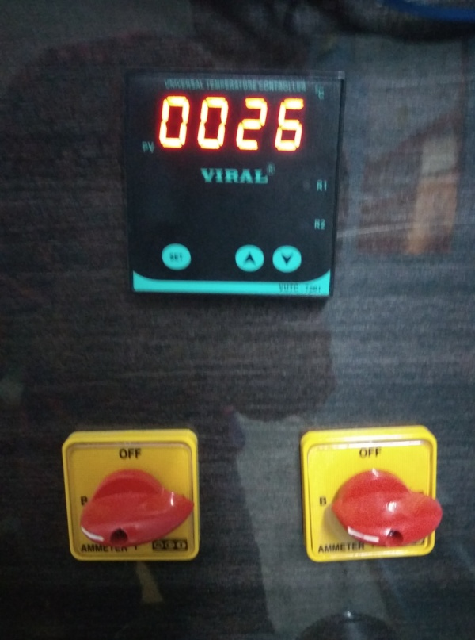
Temperature sensing probe and display devices

Slide 14
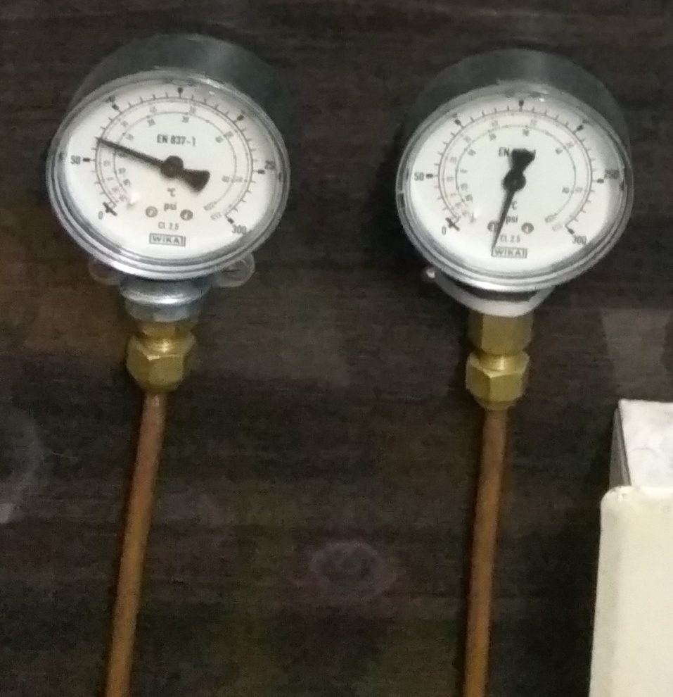
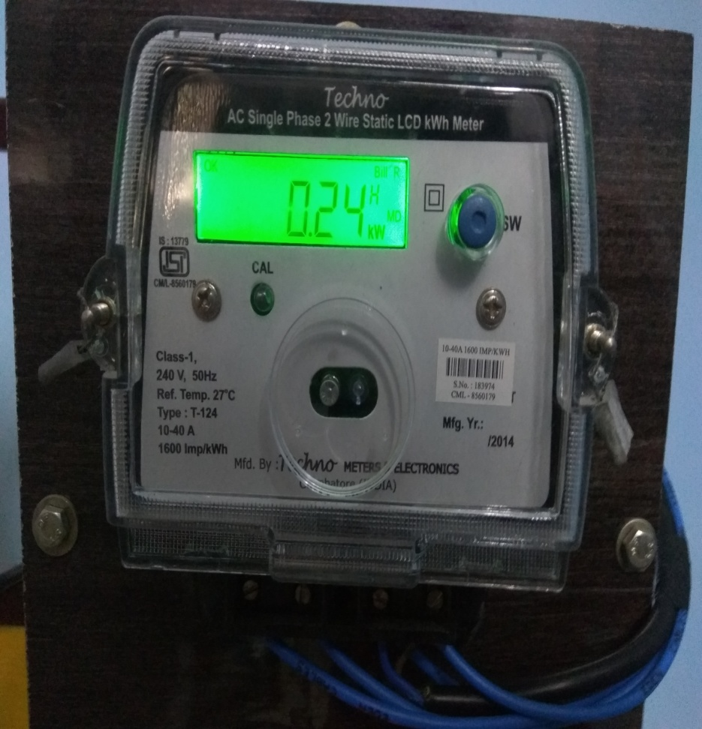
Pressure gauges and Energy meter

Slide 15
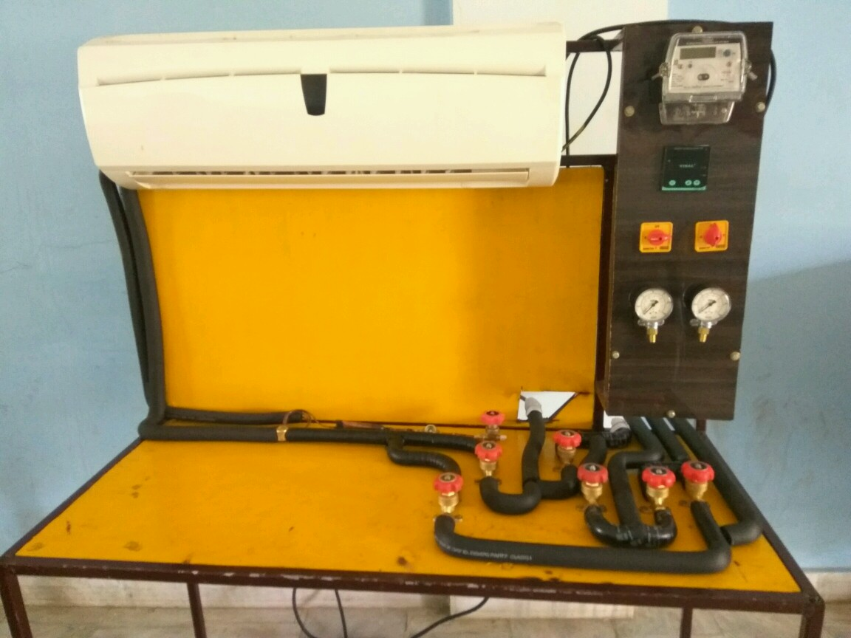
INDOOR UNIT WITH ENERGY METERS, PRESSURE GAUGES AND VALVES

Slide 16
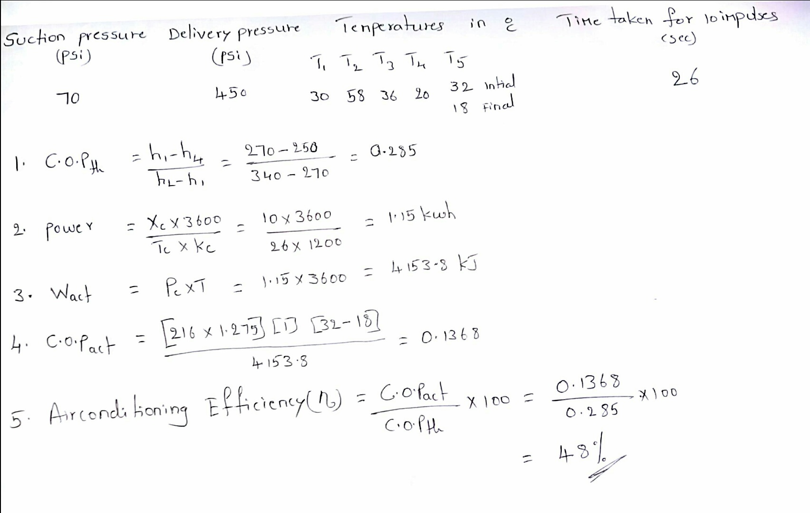
Calculation in normal condition

Slide 17
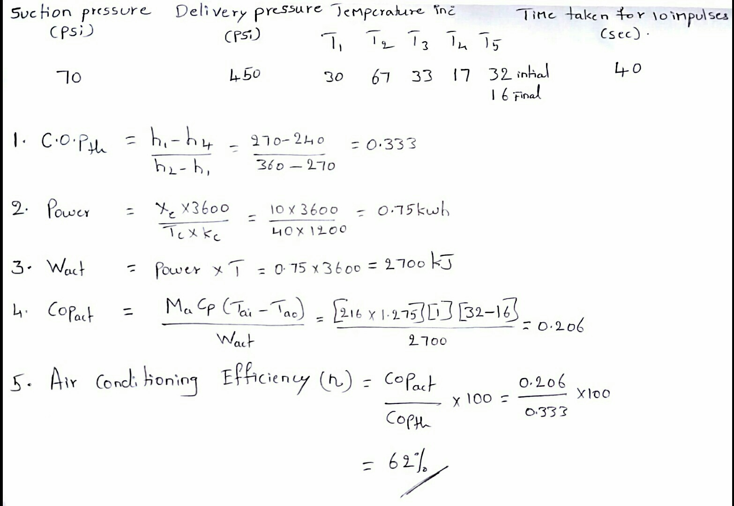
Calculation in solar added condition

Slide 18
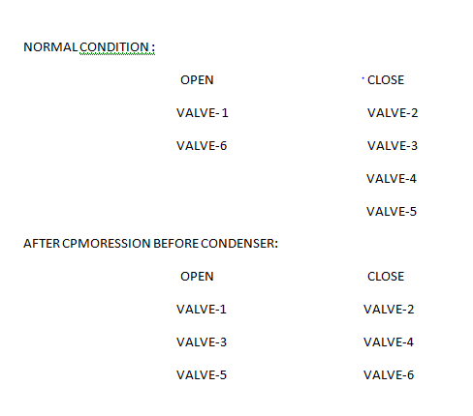
Valve operating system

Slide 19
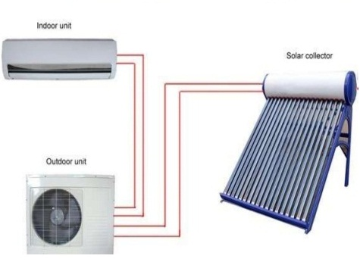
SOLAR A.C

Slide 20
Applications of solar air conditioning
Home needs
Industries
Product storage areas
Office buildings e.t.c

Slide 21
CONCLUSION
we have developed solar-assisted, split-system air-conditioner.
In this design the obtained results for the system under control and have shown energy efficiency.
Thus, the new design is improving the system performance while fulfilling the cooling demands as well as achieving high energy efficiency.

Slide 22
FUTURE PLAN
We analyzed the working of the system built with the solar thermal used air conditioned system and found 25%-43% less power consumption than the normal working condition, and we have future plan about that to install the solar thermal energy after evaporation and before compression to obtain better results than this system ,to Improve the efficiency and cop of the air conditioning system.

Slide 23
THANK YOU

